Slide 1




STUDENT PERFORMANCE INSIGHTS
Presented by Adham Mahmoud

Slide 2




Abstract
This project aims to predict student academic success using machine learning techniques. The dataset includes demographic, social, and academic features that influence student performance. Several supervised learning models—Logistic Regression, Decision Tree, and Random Forest—were trained and evaluated under both data-leakage and no-leakage scenarios. The results show that Random Forest without leakage provides the best balance between accuracy, recall, and F1-score,
while models with grade information (leakage) achieve higher but unrealistic performance. Insights from feature importance suggest that failures, absences, and parental involvement strongly impact student outcomes. These findings can support schools in early interventions, personalized tutoring, and attendance monitoring to improve overall success rates.

Slide 3




Problem & Value
Problem: Many students are at risk of failing or dropping out due to poor academic performance, absenteeism, or lack of support. Teachers and schools often lack predictive tools to identify these students early, which delays effective interventions.
Value: By building predictive models on student data, schools can:Detect
at-risk students before final exams.
Target interventions such as tutoring, counseling, or attendance monitoring.
Allocate resources more effectively to students who need the most support.
Improve overall academic performance and reduce dropout rates.

Slide 4


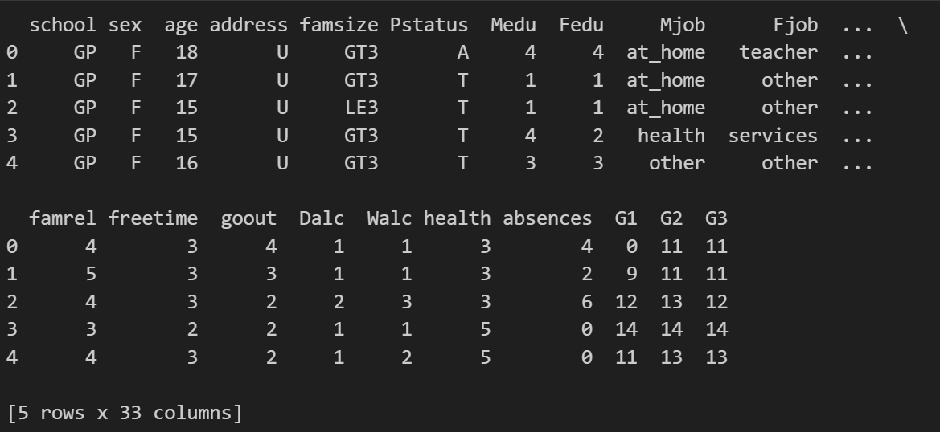


Dataset

Slide 5
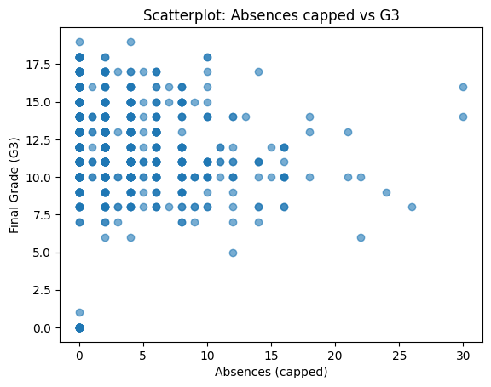
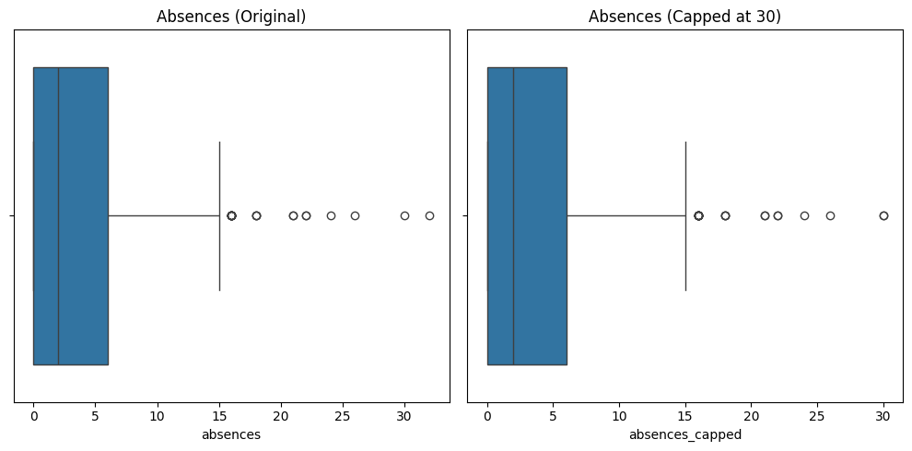


absences_capped
VS G3
absences_capped
VS absences

Slide 6


Methods
Data Cleaning & Preprocessing: We handled missing values, converted categorical variables into numerical form (one-hot encoding), and engineered new features such as pass/fail, risk, and absences_capped.
Exploratory Data Analysis (EDA): We explored distributions, correlations, and patterns (e.g., absences vs. grades, failures vs. outcomes).
Clustering: We applied K-Means to group students into behavioral/risk clusters.
Supervised Learning: We trained three algorithms—Logistic Regression, Decision Tree, and Random Forest—using two setups: with data leakage (including G1, G2) and without leakage (excluding them).
Evaluation: We used both hold-out validation and 5-fold cross-validation. Hyperparameter tuning was conducted to optimize performance.

Slide 7

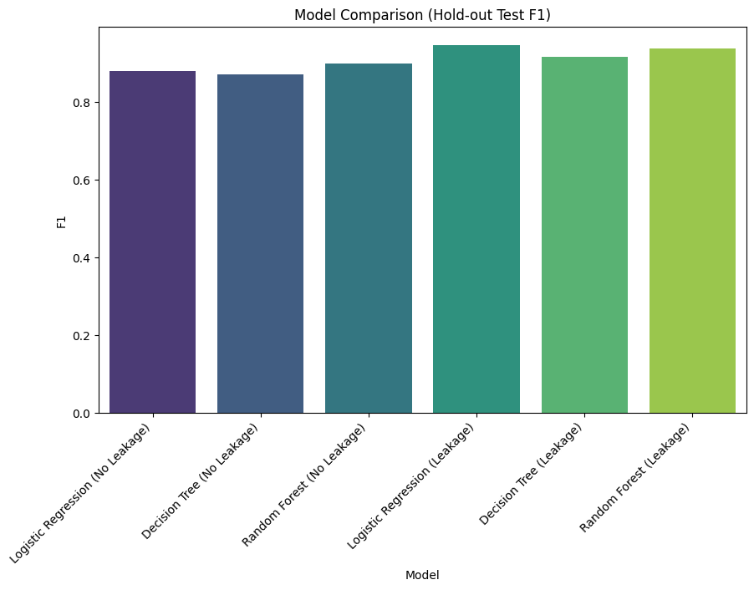
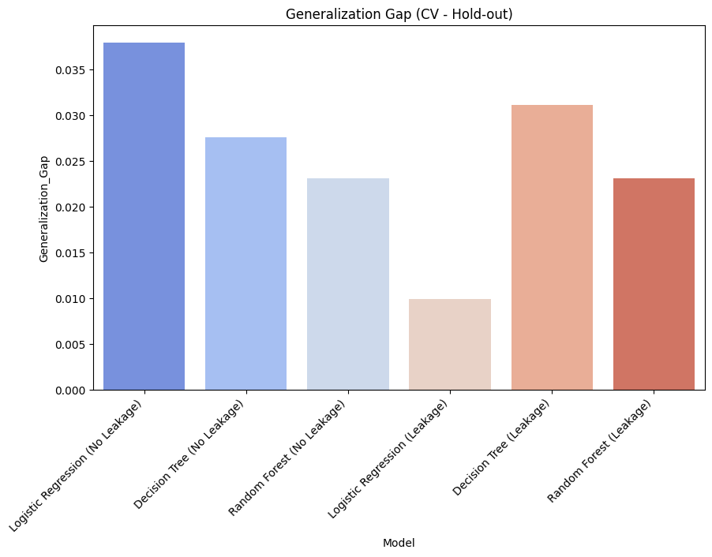
Result

Slide 8

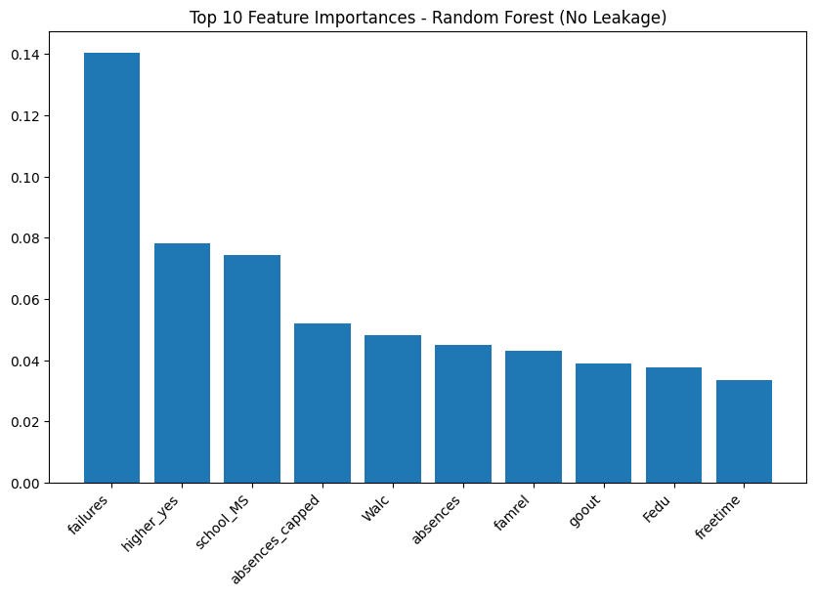
Most 10 Features

Slide 9



ethical point
Privacy: Student data must remain anonymized, as it includes sensitive educational and family background details.
Fairness: Predictions should not discriminate by gender, socioeconomic status, or family situation.
Responsible Use: Models should guide supportive interventions (tutoring, mentoring), not punitive actions.
Transparency: Educators and students should understand the model’s purpose and limitations

Slide 10


Source
The dataset is the Student Performance Dataset from the UCI Machine Learning Repository (ID = 320). It contains data collected from two Portuguese secondary schools (Math and Portuguese courses)
Manual download (zip contains student-mat.csv and student-por.csv): use the Download button on the dataset page and unzip; both files have identical schema.

Slide 11


Conclusion
Logistic Regression and Random Forest showed the best performance, especially without data leakage.
Absences and failures are the strongest predictors → early interventions are recommended.
Models are balanced with no clear overfitting; future work should include more features (behavior, support, activities) and real-world pilot testing.

Slide 12
THANK YOU
For your attention

